Slide 1
A Prime Example of HCI Application
Unity3D
https://unity3d.com/
Yingcai Xiao

Slide 2

Unity3D
Engine
IDE
Visual Programming
Assets
Tutorial
Examples

Slide 3
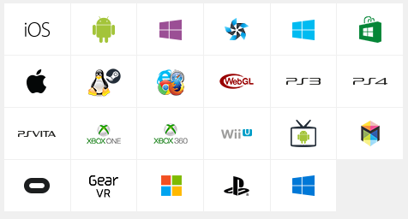
Installation
Download at https://store.unity.com/
Free for students and company < $100,000/y
Supporting multi-platforms.

Slide 4
Create your first Unity3D project

Slide 5
Getting started with a simple Unity3D project
Start Unity3D
New Project (3D or 2D)
File->Save Scene

Slide 6
Font size too small?
Right-click on the desktop
Select “Display settings”
“Change the size of text”
Default to 125%, change to 175%
for Unity IDE presentations

Slide 7
Getting started with a simple Unity3D project
Assets->Import Packages
- Characters
- Particle Systems
- Vehicles
Select components before importing each package.

Slide 8
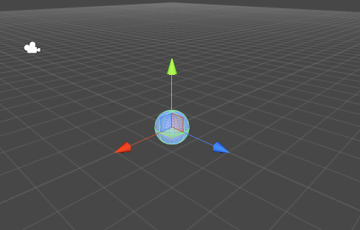
Object Creation
GameObject->3D object->sphere
Edit->Frame Select (to show the created object)
Hold onto the arrows to move the sphere or change the position in the Inspector.
Note: Y is up.

Slide 9
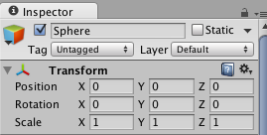

Inspector and transform panel
Moving, translation, rotation and scaling tools

Slide 10
Unity 3D: Component
Select Created Game Object->Component->Physics->Rigidbody
Rigid Objects: non-deformable with physical properties (gravity, inertial).
Non-rigid Objects:
  Deformable: changeable geometry
  Breakable: changeable topology.
Intangible Objects: No predefined shape.
fire, clouds, …

Slide 11
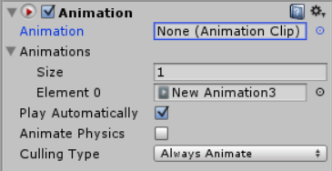
Animation
Window->Animation
Click on the object to be animated.
Component->Miscellaneous->Animation

Slide 12
Animation
Create New Animation Clip
Click on the record button (red) at the top-left.
Save the new animation clip file.
Click on Curves.
Select Add Property->transform → position, rotation or scaling

Slide 13
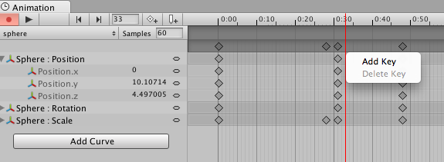
Animation
Add key frame on the timeline as many as you want.
Click on the red button again to finish making the animation clip.

Slide 14
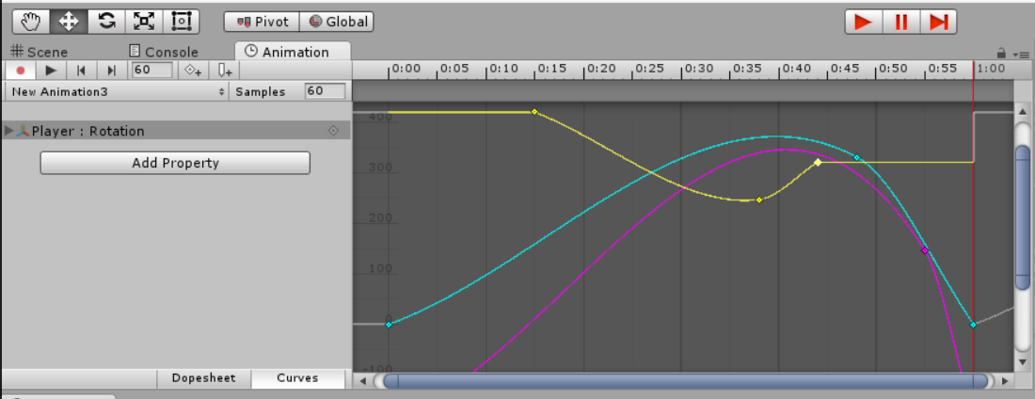
Animation (Unity5)
Add key frame on the timeline as many as you want.
Click on the red button again to finish making the animation clip.

Slide 15
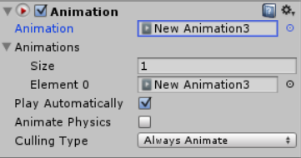
Animation
Go back to Unity window.
Under Inspector → Animation , change the name of animation clip from none to the one that you have made.

Slide 16
Animation Event
Allows you to call functions in the object’s script at specified points in the timeline.
Add a new Animation Event by double-clicking the Event Line or by using the Event button.

Slide 17
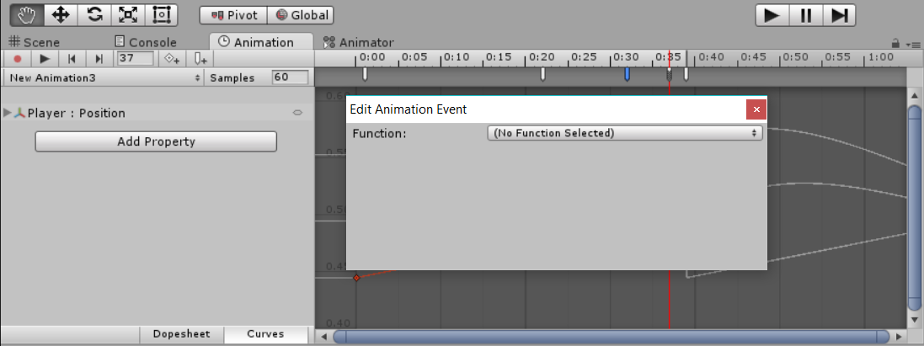
Animation Event
When you add an event, a dialog box will appear to prompt you for the name of the function and the value of the parameter you want to pass to it.

Slide 18
Unity 3D: Light
Game Object ->Light -> Directional Light (Default)
Move and rotate just like any other object.

Slide 19
Terrain
GameObject → 3D Object → Terrain
In the hierarchy panel, select Terrain.
In the Inspector: set x = -5, y = 0, z = -5.
Click on one of the action icons in Terrain (Script) to raise/lower terrain, paint height, smooth height, paint texture, place trees, paint details, terrain setting. Adjust brush size to 1 before performing the operations.
Paint Texture: Edit Texture -> Select

Slide 20
Terrain
To place trees, you have to build tree first (Game Object->3D object ->Tree), then choose“Edit Trees -> Add Trees” first to add different types of trees.
In the Add Trees popup window, you need click on the little circle at the right-most of the “Tree” row.
Select, say, Palm and then click on “Add” in the “Add Tree” window.
Go back to the Inspector, select “Mass Place Trees” from available “Trees” to add.

Slide 21
Physics
Unity3D provide Physics library.
- Rigidbody, collider, joint, force and etc.
Rigidbody component : gravity automatically added
Collision detection : box, sphere, capsule , mesh, whelle and terrain.
Collision call back function : OnCollisionEnter,
OnCollision and OnCollisionExit.

Slide 22
Player (for a third-person game)
Make sure to save the scene “File->Save Scene” (Ctrl S”) and save the project
“File->Save Project”
Next, we need add the player.
In the Project window, drag“Standard Assets->Character Controllers->3rd Person Controller”
to the Hierarchy window.
In the Hierarchy window, double-click on the 3rd Person Controller.
Click on the “Move selected object” icon. Then move the controller to the top of the terrain. You may have to adjust your view angle by clicking on the ‘xyz” icon to see the position. Click the middle of the icon to get the perspective view.

Slide 23
Unity 3D: Play
Now click on the “Play” icon and use the arrow keys to controll the player.
You should see the player running around and make sure he does not run off the edge.

Slide 24

Under the Hood

Slide 25
HCI Programming Essentials
EDP: Event Driving Programming
Event generators (input devices)
Events
Event loop
Event mapping (compile time)
Event dispatching (run time)
Event handlers
Computation
Output

Slide 26
HCI Programming in Unity
Event generators (input devices)
Unity takes input from almost all input devices:
CLI: keyboard
GUI: mouse, touch screen
NUI: Kinect, LeapMotion, Smart Phones

Slide 27
HCI Programming in Unity
2. Events
2.A. Virtual Events: Horizontal/Vertical Movements
2.B. Software Events: Collision
2.C. Idle Event: for background activities
2.D. User defined events: at any key points of computation.

Slide 28
HCI Programming in Unity
3. Event loop
Unity takes care of it.
3.A. At coding time: visual programming
3.B. At application run time: API libraries built into the application.

Slide 29
HCI Programming in Unity
4. Event mapping (compile time)
4.A. At coding time: visual programming
4.B. At application run time: can be done, but no API yet.

Slide 30
HCI Programming in Unity
5. Event dispatching (run time)
At application run time: done by unity built-in runtime libraries.
Visual Programming:
Events distributed by the Unity IDE to
IDE when coding
Application when simulating (play)
Debugger when in the debugging mode.

Slide 31
HCI Programming in Unity
6. Event handlers
6.A. Written by the application programmer.
6.B. Built-in by the Game Engine (Physics Engine, AI Engine, …)
6.C. Imported as part of the prefabricates.

Slide 32
HCI Programming in Unity
7. Computation
7.A. Written by the application programmer.
7.B. Built-in by the Game Engine (Physics Engine, AI Engine, …)
7.C. Imported as part of prefabricates.

Slide 33
HCI Programming in Unity
8. Output
8.A. Audio: sound tracks
8.B. Video: animated graphics
8.C. Haptic: force feedback

Slide 34
HCI Programming in Unity
8.B. Graphics Output
8.B.1. Local: OpenGL
8.B.2. Remote: WebGL
8.B.3. Others: XR: VR/AR/MR

Slide 35
HCI Programming Essentials
EDP: Event Driving Programming
Event generators (input devices)
Events
Event loop
Event mapping (compile time)
Event dispatching (run time)
Event handlers
Computation
Output

Slide 36
HCI Programming Essentials
EDP: Event Driving Programming
Project: directory and files for a specific game project.
C:\Users\xiao\Documents\New Unity Project 1
\Assets (anything you can reuse)
\Library (binary files)

Slide 37
Unity 3D IDE
IDE: Integrated Development Environment
Project: directory and files for a specific game project.
C:\Users\xiao\Documents\New Unity Project 1
\Assets (anything you can reuse)
\Library (binary files)

Slide 38
Unity 3D: Assets
C:\Users\xiao\Documents\New Unity Project 1\Assets (anything you can reuse)
\Standard Assets
\OpenNI
\Scripts
\_Scenes
\Materials
\Artwork

Slide 39
Unity 3D: Standard Assets
C:\Users\xiao\Documents\New Unity Project 1\Assets\Standard Assets
Objects: (Look)
\Tree
\Terrain
\Charater
Lights: (Look)
\Light Flares
\Light Cookies
Code: (Feel: control, interaction, animation, …)
\Scripts

Slide 40
Unity 3D: Objects
C:\Users\xiao\Documents\New Unity Project 1\Assets\Standard Assets\Charater:
Prefab: (Predefined Objects)
First Person, 3rd Person
\Source:
\Prototype (Look)
Constructor.FBX
\Materials (properties)
\Textures (images)
    \Scripts (Feel: actions)
Java Scripts: ThirdPersonController.js
C#: MouseLook.cs

Slide 41
Unity 3D: Scripts
Languages:
Interpreted : Java Script
Compiled: C#
Usages:
General: under Project\Scripts
ExitOnEscape.cs
Objects: attached to objects
ThirdPersonController.js

Slide 42
Unity 3D: Library
cashe:
for speeding up processing
metadata:
data that describes data
previews:
for previewing scenes
ScriptAssemblies:
compiled object assemblies for scripts

Slide 43
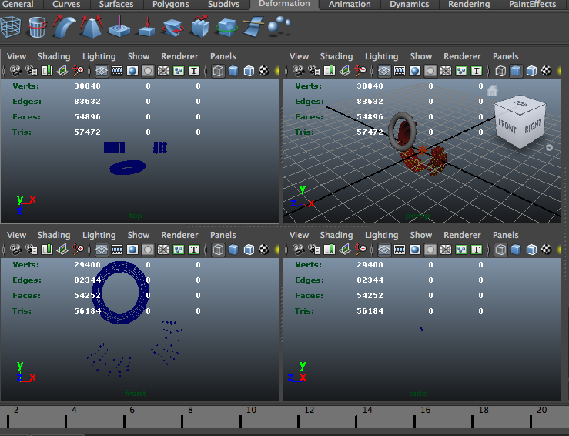
Resources for 3D model
http://www.turbosquid.com
Autodesk Maya
http://www.autodesk.com/products/autodesk-maya/overview
Blender
http://www.blender.org

